Slide 1
MNIST Classification: Multiple Linear Regression and Logistic Regression
CMPUT 328
Nilanjan Ray

Slide 2
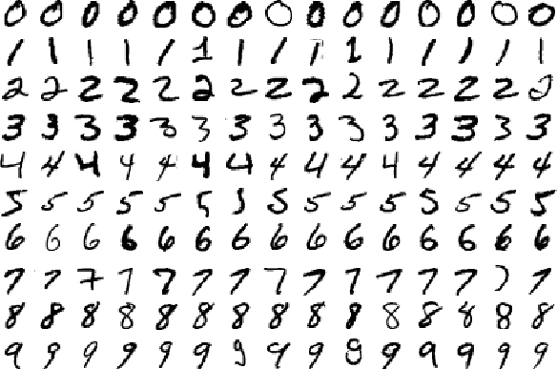
MNIST Dataset
Classify images into digits
Each image is 28x28
10 labels
55,000 training images
5,000 validation images
10,000 test images.

Slide 3
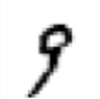
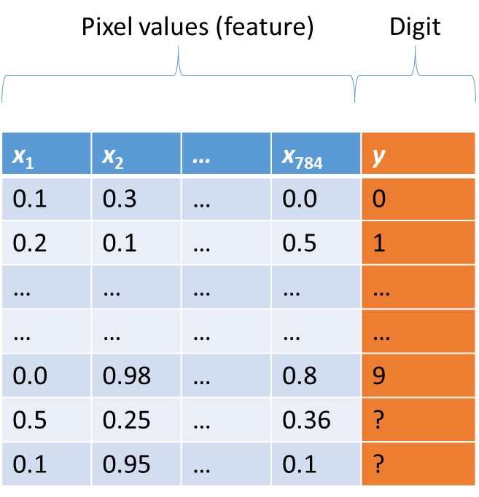
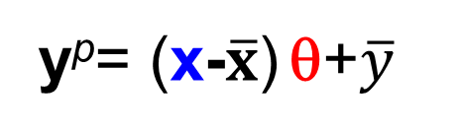
Linear regression
So, far we have seen:
Image (1x784)
Parameters (784x1)
y^{p}= (x-$\overline{x}$) θ+$\overline{y}$
1 number, indicating digit
Mean of training labels (digits)
[28x28]
Array of real numbers (784 numbers total)
Mean vector of training images

Slide 4
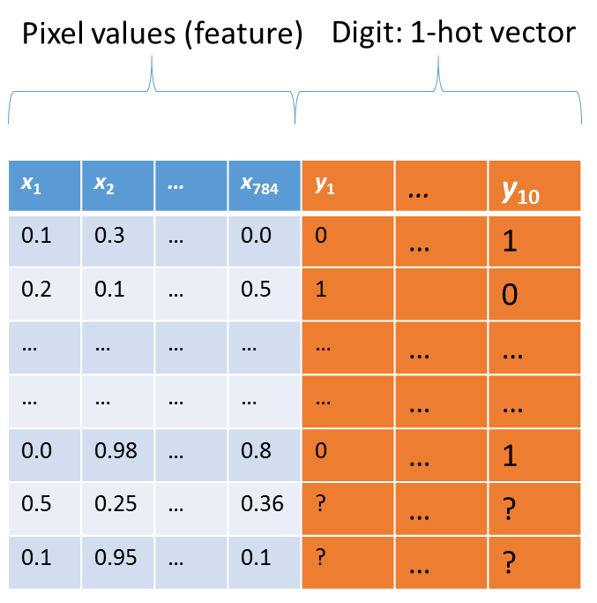
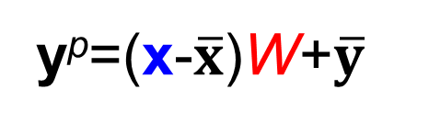
Multiple or Vector Linear Regression
Image (1x784)
Parameters (784x10)
y^{p}=(x-$\overline{x}$)W+$\overline{y}$
10 numbers, indicating class scores
Mean of 1-hot training label vector
[28x28]
Array of real numbers (784 numbers total)
Mean vector of training images

Slide 5
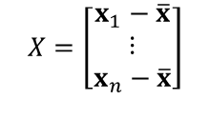
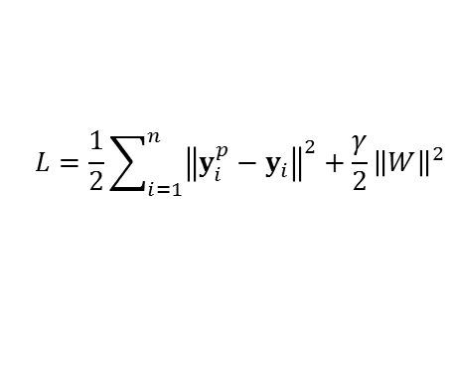




Multiple Linear Regression: PyTorch Implementation
Prediction model:
$$y^{p}=(x−\overline{x})W+\overline{y}$$
Regularized loss function:
$$L=\frac{1}{2}\sum_{i=1}^{n}{{\left\|y_{i}^{p}−y_{i}\right\|}^{2}}+\frac{γ}{2}{\left\|W\right\|}^{2}$$
https://en.wikipedia.org/wiki/Matrix_calculus
This derivation requires
matrix-vector differentiation
Gradient of loss function:
$$∇L=\left(X^{T}X+γI\right)W−X^{T}Y$$
$$X=\left[\begin{matrix}x_{1}−\overline{x} \\ ⋮ \\ x_{n}−\overline{x}\end{matrix}\right]$$
Equating gradient of L to zero matrix and solving for W gives us:
where matrix X is defined as:
$$Y=\left[\begin{matrix}y_{1}−\overline{y} \\ ⋮ \\ y_{n}−\overline{y}\end{matrix}\right]$$
and matrix Y is defined as:
$$W={(X^{T}X+γI)}^{−1} X^{T}Y$$
and I is an identity matrix of size 784-by-784
We will “minimally” modify our linear regression scripts into multiple linear regression implementations!

Slide 6
Logistic Regression
Would it not be nice if we can predict class probabilities instead of scores?
image
parameters
10 numbers, indicating class probabilities
y^{p} = f(x,W)
[28x28]
Array of real numbers (784 numbers total)
prediction function
For logistic regression

Slide 7
Logistic Regression
Can we modify scores from multiple regression function to output probabilities?
What is a suitable loss function for classification?

Slide 8


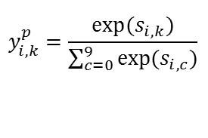
Logistic regression: from multiple linear regression
Scores from multiple linear regression:
$$s_{i}=(x_{i}−\overline{x})W+\overline{y}$$
or
$$s_{i,k}={(x_{i}−\overline{x})W}_{:,k}+{\overline{y}}_{k}$$
Score for k^{th} class, k = 0,…,9
Predicted probability for k^{th} class:
$$y_{i,k}^{p}=\frac{exp⁡(s_{i,k})}{\sum_{c=0}^{9}{exp⁡(s_{i,c})}}$$
“Softmax” function

Slide 9
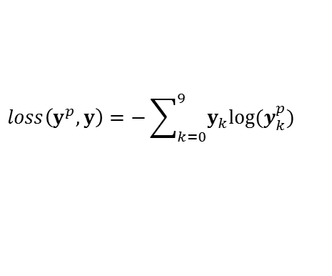
Logistic regression: loss function
Cross entropy loss:
$$loss\left(y^{p},y\right)=−\sum_{k=0}^{9}{y_{k}log⁡(y_{k}^{p})}$$
Why this loss function? What does it mean? Why not use Euclidean loss as in MLR?

